Slide 1
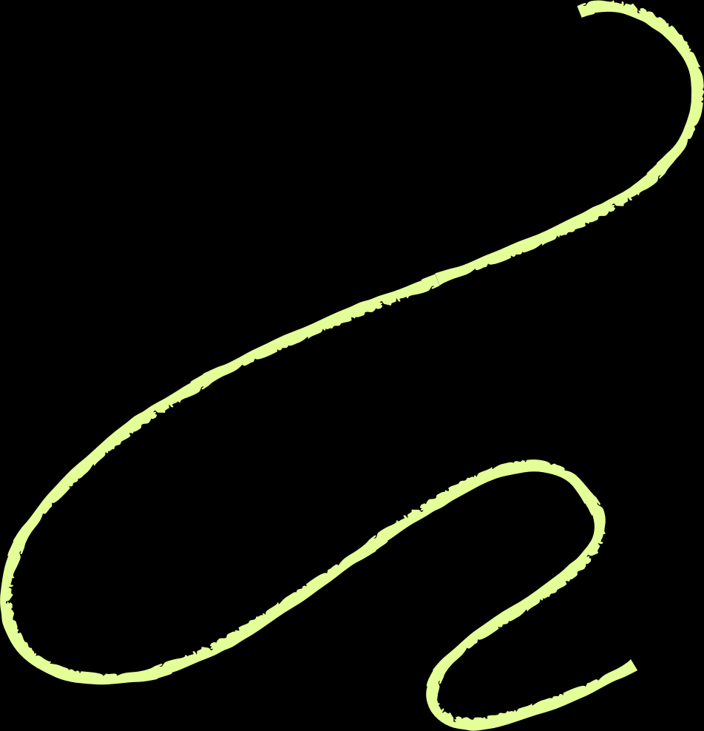






Disease detection system
By Team Trivedya

Slide 2



The team

Slide 3



The team
Shivansh Goel
E23cseu0124
Aryan Diggal
E23cseu0125
Riya Patel
E23cseu0126

Slide 4
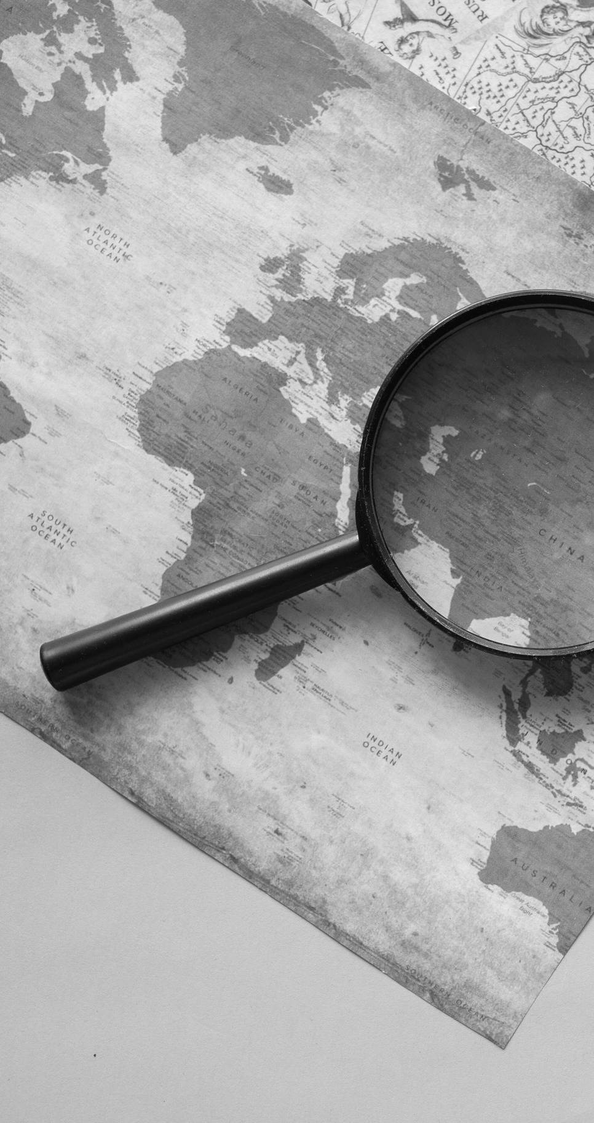

The idea
Our project, “Disease Detection using Machine Learning," is a straightforward Python-based program designed to assist in the early detection of common diseases. This project aims to make healthcare more accessible and user-friendly by using machine learning to enhance diagnosis accuracy.

Slide 5
key features

Slide 6

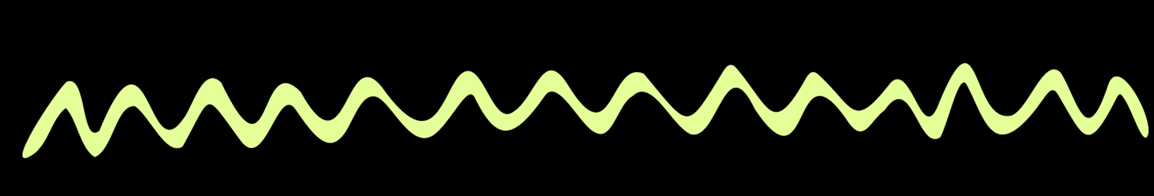

Key features
1
2
3
Users will input some health information like age, gender, and a few information that we can get from doing pathological tests. The system will then use a machine learning model to predict the likelihood of specific disease.
We will develop a simple and intuitive interface where users can easily input their information and receive a disease prediction.
While keeping things simple, we will ensure that the predictions are as accurate as possible. We will evaluate the model's performance to make sure it provides reliable results for the included diseases.

Slide 7



Our program would be able to detect :-
1. Skin Cancer
2. Parkinson’s Disease
3. Heart Disease
4. Diabetes

Slide 8
Work Distribution
The Skin Cancer detection
1. Parkinson’s
Disease detection
Heart Disease
2. Frontend
2. Frontend
2. Diabetes detection
Aryan Diggal
Shivansh Goel
Riya Patel

Slide 9


CORPORATE WELLNESS PROGRAMS
PHARMACIES AND WELLNESS CENTERS
LOW-RESOURCE SETTINGS
APPLICATION
AREAS
PERSONAL HEALTH AND WELLNESS APPS
TELEMEDICINE
PRIMARY HEALTHCARE CENTERS

Slide 10



THANK YOU

